Slide 1
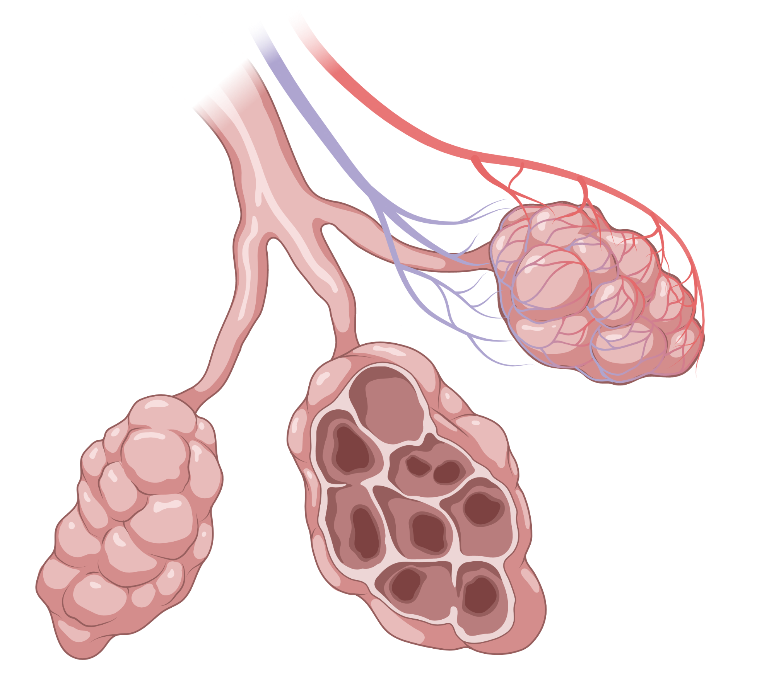

Diagnosis
Classification
Management
Efficacy
Outpatient Management of Chronic Obstructive Pulmonary Disease (COPD)
Exacerbations
Cases
Graphic created with BioRender.com

Slide 2
Diagnosis
Diagnosis
Classification
Criteria for diagnosis?
Criteria for diagnosis?
Criteria for diagnosis?
Initial evaluation
Initial evaluation
Initial evaluation
Management
Tobacco smoke
Other smoke, vapor, or dust exposure
Host factors (genetics, prematurity, frequent respiratory infections)
Tobacco use history
Exposure history
Consider α-1 antitrypsin
1. Risk Factors
Efficacy
1. Risk Factors
Exacerbations
Cases
Dyspnea
Chronic cough
Sputum production
Recurrent LRTI
CXR
ABG (if SpO₂ <92%)
CT chest (FEV1 <45%, severe symptoms, lung cancer screen)
2. Symptoms
2. Symptoms
Flow
 | % Ref (pre) | Post Meas | % Chg (post)
FEV1 | 30 |  | 7
FVC | 75 |  | 8
FEV1/ FVC |  | 0.47
Post- bronchodilator FEV1/FVC ratio <0.7 is mandatory for diagnosis!
Scooped out appearance
3. Spirometry
Flow-volume loop?
3. Spirometry
Volume
Other PFT findings?
±↑TLC, ↑RV, ↓DLCO
Notes:
GOLD 2023 diagnosis – heterogenous lung condition characterized by chronic respiratory symptoms (dyspnea, cough, sputum production, exacerbations) due to abnormalities of the airways (bronchitis, bronchiolitis) and/or alveoli (emphysema) that cause persistent, often progressive airflow obstruction
Diagnostic criteria
Symptoms/ clinical context + non-fully reversible airflow limitation (FEV1/FVC <0.7 post-bronchodilation) measured by spirometry
Spirometry mandatory for diagnosis!! You cannot diagnose COPD WITHOUT PFTs!
Some patients with respiratory symptoms or structural lung lesions (emphysema) without airflow obstruction (ratio <0.7) is NOT considered to have COPD. They may be labelled “pre-COPD” in these new guidelines. There is another category called PRISm (Preserved Ratio Impaired Spirometry). Both pre-COPD and PRISm are at risk of developing COPD over time, but not all.
Risk Factors
Cigarette smoking is key environmental RF. Other types of tobacco (pipe, cigar, water pipe) and THC are also risk factors.
Environmental exposure (e.g., smoking during pregnancy or exposure at home) poses risk as well.
Occupational exposure to organic, inorganic dust, chemical agents and fumes are also a risk factor
Chronic bronchitis is a variable condition in patients with COPD. Defined as presence of cough with expectorated sputum on regular basis. Classic definition is cough and sputum production for > 3 months/year x 2 y without other conditions to explain this.
History of severe childhood respiratory infections has been associated with reduced lung function.
M>F
Other evaluation
Spirometry is needed for diagnosis
Ambulatory pulse ox and ABG assessment. If SpO2 <92% -> pursue ABG
6 MWT tests exercise capacity
CXR is not useful to diagnose COPD but can exclude other diagnoses. May see signs of hyperinflation
CT is not a requirement but is used increasingly in patients with COPD. However, in patients with symptoms out of proportion to disease severity on lung function, FEV<45% with significant hyperinflation, or need lung cancer screening, consider CT scan
A1AT testing should be done once with all patients with COPD. Especially if young (<45 yo) and with panlobular basal emphysema
Pathophysiology/ Spirometry
Increased residual volume (RV) is due to gas trapping – inability to completely exhale. This happens early in the disease.
Increase TLCO is due to static lung hyperinflation. This is related to loss of elastic recoil. This occurs later in the disease. When this occurs during exercise, it’s called dynamic hyperinflation. Bronchodilators act on peripheral airways to reduce gas trapping.
Decreased DLCO has to do with parenchymal destruction with emphysema. It should be measured in any person with symptoms disproportionate to degree of airflow obstruction since values <60% are a/w increased symptoms, increased risk of death.
Maximal effort is needed to avoid underestimation of values
Patients already on bronchodilators should stop regular treatment for spirometry
Post bronchodilator response is needed to assess the degree of reversibility of airflow obstruction for diagnosis (but not for follow-up)
The degree of reversibility can vary over time and does not reliably differentiate from asthma or predict response to long term bornchodilators or cortichosteroids

Slide 3
Diagnosis
Classification
Classification
Scores of symptom severity
Modified Medical Research Council Dyspnea Scale
mMRC
COPD Assessment Test
CAT
Management
Assesses health status in COPD
Each scored 1-5
Score | Symptom severity (Dyspnea)
0 | Strenuous exercise
1 | Hurrying, walking up slight hill
2 | Walking
3 | <100 y or few min
4 | With ADLs
Efficacy
Cough
Phlegm
Chest tightness
Breathlessness
Activities
Confidence
Sleep
Energy
Exacerbations
Cases
Score <10
Score >10
COPD classification
3
Group E
≥2 exacerbation or at least 1 requiring hospitalization
Group A
2
Group B
Exacerbations/ year
Group A
mMRC 0-1|CAT <10
0-1 exacerbations
Group B
mMRC ≥2|CAT ≥10
0-1 exacerbations
1
Group E
0
Symptoms
Mild
Moderate
Severe
Notes:
LABA – good for symptoms, less helpful for exacerbations. LAMA is better in 2 head-to-head RCTs
LAMA – good for symptoms and reducing exacerbations
ICS – good for exacerbations if elevated eos. Comes with risks
Group A – LAMA or LABA > SABA or SAMA except for patients with very rare symptoms.
Group B – LABA + LAMA >LAMA alone with regards to several endpoints. IF not appropriate, LAMA or LABA is fine depending on what patient feels provides symptom relief.

Slide 4
Diagnosis
Management
Classification
Group A
Group B/E
Summary
Management
Efficacy
Exacerbations
Efficacy
Cases

Slide 5
Diagnosis
Management
Classification
Group A
Group B/E
Summary
Management
Efficacy
Initial therapy?
Subsequent therapy depends on predominant features
Consult pulmonology
for additional therapies
Exacerbations
LABA
LABA
LABA
OR
LAMA
Cases
LAMA
LAMA
ICS
Persistent dyspnea?
Persistent dyspnea?
Persistent dyspnea
Persistent dyspnea
Exacerbations
Exacerbations?
Exacerbations
+ eos ≥100
Exacerbations?
Exacerbations
Exacerbations?

Slide 6
Diagnosis
Management
Classification
Group A
Group B/E
Summary
Management
Efficacy
Initial therapy?
LABA
Consult pulmonology
for additional therapies
LVRS
EB valve
Lung Transplant
Exacerbations
LABA
LAMA
Cases
LAMA
Azithromycin
Roflumilast
ICS
Persistent dyspnea?
Persistent dyspnea
Persistent dyspnea
Exacerbations?
Exacerbations
+ eos ≥100
Exacerbations
Exacerbations?

Slide 7
Diagnosis
Management
Classification
Group A
Group B/E
Summary
Management
Frequent PNAs
Efficacy
LABA
LABA
Consult pulmonology
for additional therapies
Exacerbations
LVRS
EB valve
Lung transplant
Azithromycin
Roflumilast
LABA
OR
LAMA
Cases
LAMA
LAMA
ICS
↑ PNAs
LABA
Persistent dyspnea
Persistent dyspnea
ICS
Exacerbations
Exacerbations
+ eos ≥100
Exacerbations

Slide 8
Diagnosis
Management
Group A
Classification
Group A
Dyspnea predominant
Exacerbation predominant
Persistent sx
Frequent or severe exac
Management
Group B
Group B
Group E
Group E
Efficacy
LABA+LAMA
LABA or LAMA
LABA+LAMA
± ICS if eos ≥300
Cases
Persistent symptoms
Uncontrolled exac
Switch inhaler
Non-pharm tx
R/o other causes
Blood eos
Consider withdrawing steroids
Blood eos
≥100
<100
LABA+LAMA+ICS
+ Azithromycin
(esp if smoker)
Pneumonia or no response?
Pneumonia or
no response?
+ Roflumilast
(FEV1 <50% + CB)
Notes:
LABA – good for symptoms, less helpful for exacerbations. LAMA is better in 2 head-to-head RCTs
LAMA – good for symptoms and reducing exacerbations
ICS – good for exacerbations if elevated eos. Comes with risks
Group A – LAMA or LABA > SABA or SAMA except for patients with very rare symptoms.
Group B – LABA + LAMA >LAMA alone with regards to several endpoints. IF not appropriate, LAMA or LABA is fine depending on what patient feels provides symptom relief.

Slide 9
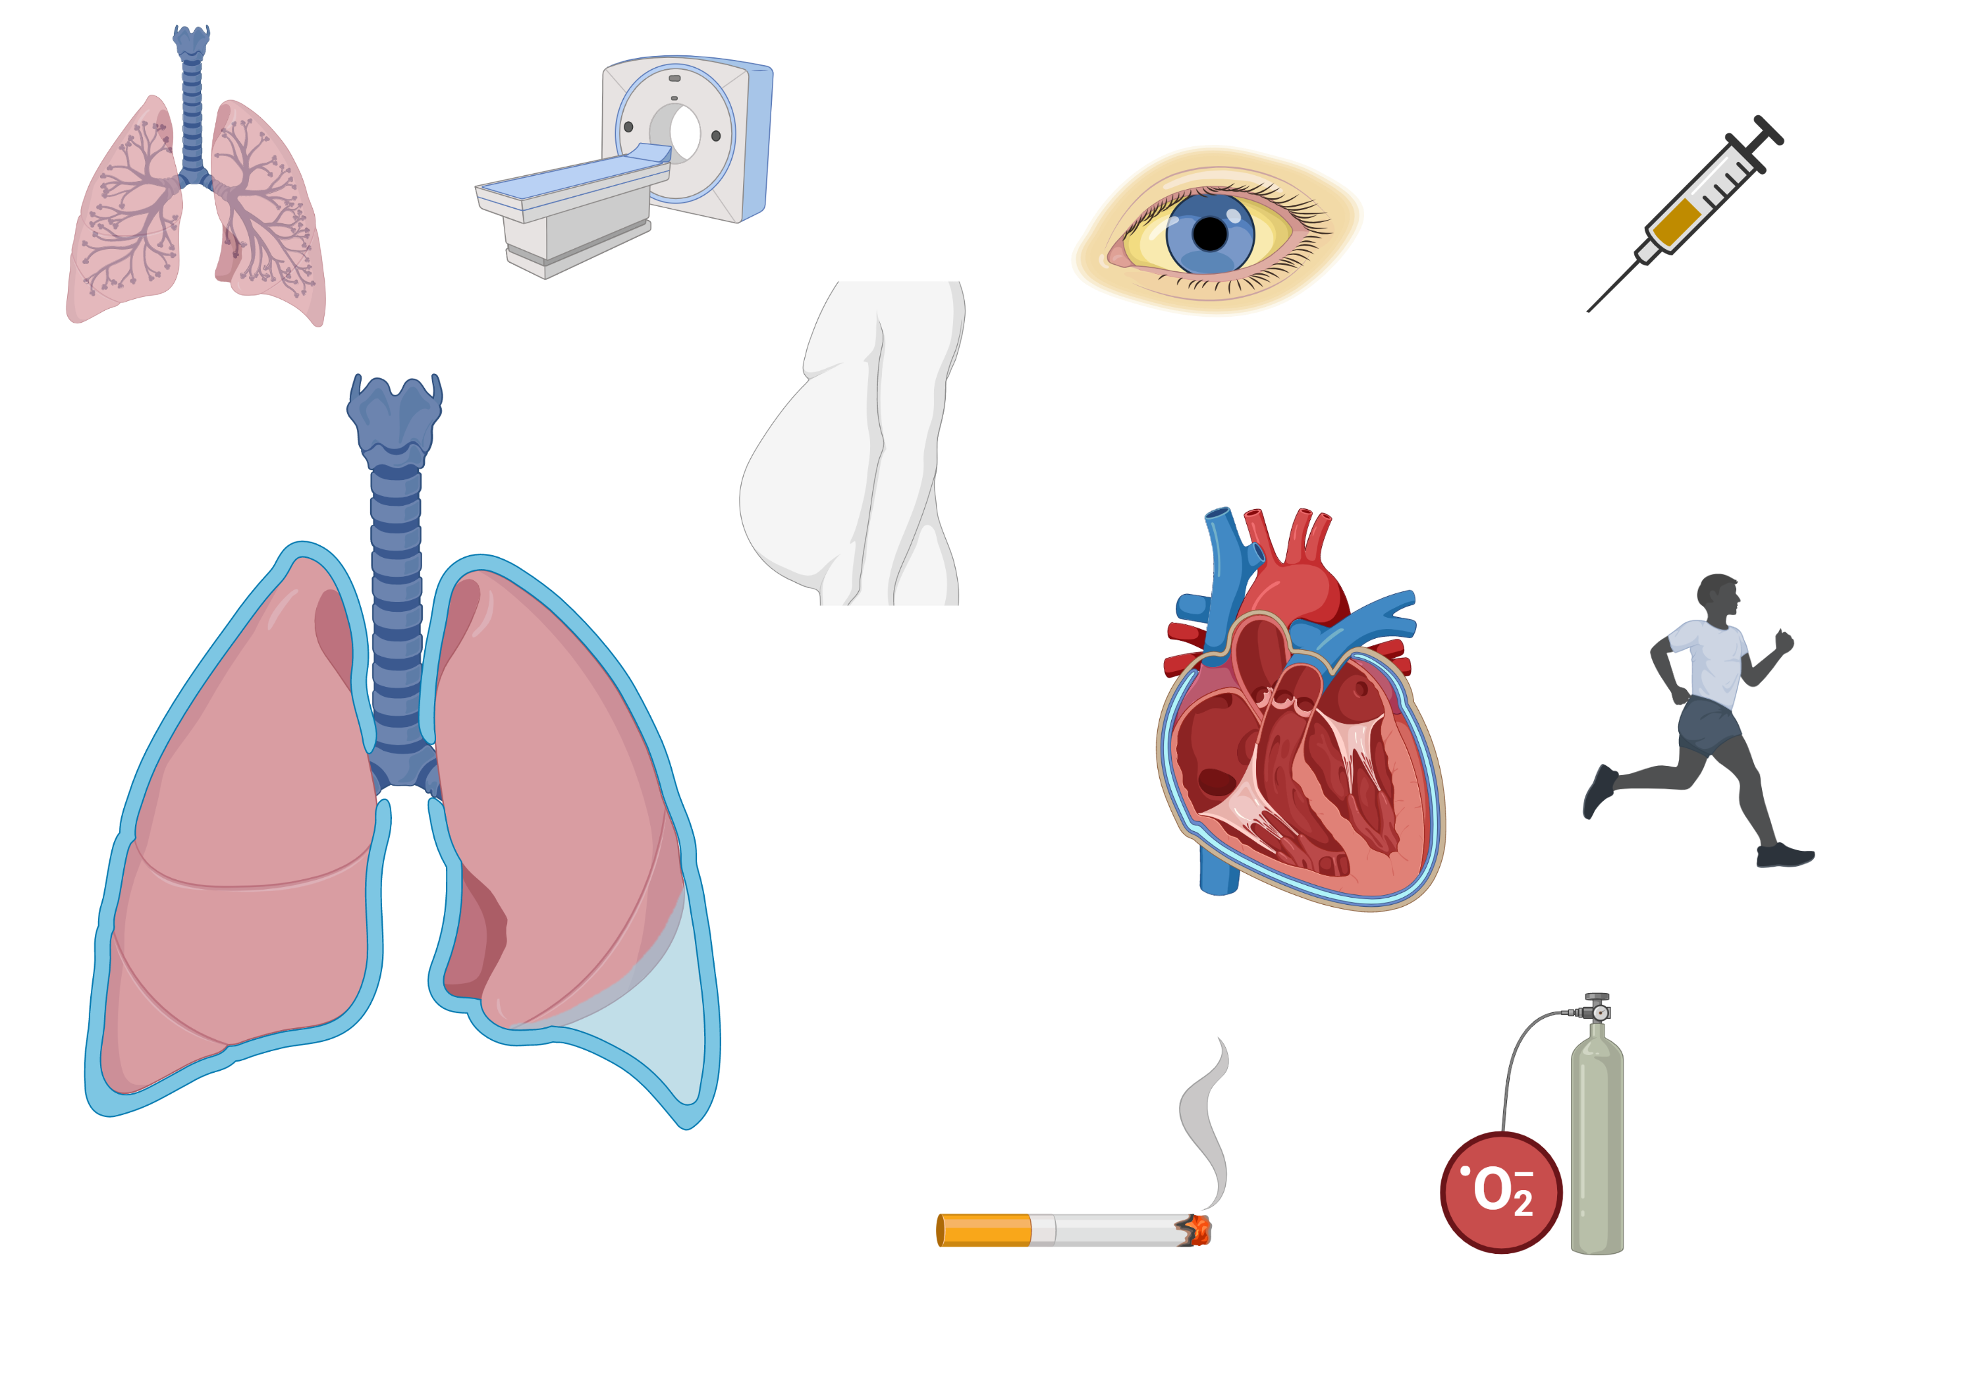
Diagnosis
Efficacy of nonpharmacologic therapies
Classification
Reduce exacerbations
Reduce symptoms
Improve Function
Slow Progression
Prevent
Death
Management
+
+
+
+
+
Efficacy
Smoking Cessation
Exacerbations
O₂
O₂
Therapy
+
+
+
+
Cases
PaO₂ <55 or PaO₂<60 +RHF
+
+
+
+
Pulm Rehab
Lung cancer
screening
+
Vaccines
Vaccines
+
?
For severe COPD
Notes:
PDE4 – reduce inflammation. No bronchodilator activity. Reduces moderate and severe exacerbations treated with systemic corticosteroids in patieths with severe to very severe COPD and history of exacerbations. Benefits greatest with prior history of hostpialziation for acute exacerbation.
Prophylactic, continuous antibiotics – azithromycin 250 mg /day x 1 y reduced risk of exacerbations compared to usual care. Increased incidence of bacterial resistance and impaired hearing.
Multiple other drugs have potential to reduce exacerbations. Monoclonal antibodies – benralizumab, mepolizumab.
Oral steroid therapy – no role in chronic daily treatment of COPD.
Vaccinations:
Flu vaccine can reduce serious illness. Reduces exacerbations. Should use live inactivated or killed viruses because they’re more effective.
COVID vaccine is recommended.
1 dose of PCV20 or 1 dose of PCV 15 followed by PPSV23. Reduces CAP and exacerbations.
dTAP for people wo were not vaccinated in adolescence.
Shingles to protect against shingles.

Slide 10
Diagnosis
Acute Exacerbations
Classification
Cardinal symptoms:
↑ dyspnea
↑ sputum volume
↑ sputum purulence
±CXR
±D-dimer
±ECG, troponin
±BNP
Acute exacerbation
Acute exacerbation?
Rule out other causes
Rule out other causes
Management
Exacerbations
Mild
Moderate
Severe
Severity?
Cases
RR<24, HR<95, CRP<10
SaO₂≥92% and <3%
RR≥24, HR≥95, CRP>10
SaO₂<92% and ≥3%, ±pCO₂>45
RR≥24, HR≥95, SaO₂<92%
pH<7.35, pCO₂>45
Hospitalization?
If confusion, severe comorbidities, inadequate home support
Hospitalization?
Antibiotics per local resistance. (↓ short-term mortality, relapse)
If >2 symptoms (including sputum purulence) or requires ventilation
Antibiotics?
Antibiotics?
Steroids?
Prednisone 40 mg x 5 d (↓ rate of relapse and symptoms)
If limits ADLS
Steroids?
Bronchodilators?
Bronchodilators?
SABA ± SAMA. MDIs as effective as nebulizers when used appropriately
NIPPV?
pH<7.35 and pCO₂>45
NIPPV
Notes:
If there’s room, add 5 days as duration of abx too
They don’t recommend for or against procal use yet – so maybe we should just leave it out and can mention in the teaching script that more studies are still needed.
For “which agent” – we might want to consider adding a little * or something stating that it really depends on local resistance patterns. GOLD doesn’t offer very much specific guidance on antibiotic choice for this reason. GOLD does support our azithro/doxy rec but doesn’t mention any specific antibiotic choice for high risk patients – rather it suggests sputum cultures (should we add that? Though not very practical for outpatient) and pseudomonas coverage. Trevor still feels like our antibiotic recs here are pretty universal so I think it’s OK to leave them, just with that caveat about following local resistance patterns.

Slide 11
Diagnosis
Acute Exacerbations
Cardinal symptoms:
↑ dyspnea
↑ sputum volume
↑ sputum purulence
±CXR
±D-dimer
±Flu swab
±BNP, ECG, trop
Classification
Acute exacerbation
Acute exacerbation?
Rule out other causes
Rule out other causes
Management
Efficacy
Severe exacerbation: resting dyspnea, ↑ O2 requirement, confusion
Severe comorbidities
Insufficient home support
Exacerbations
Hospitalization?
Hospitalization?
Cases
If new symptoms limit daily activities.
↓ rate of relapse and symptoms.
Dose and duration?
Prednisone 40 mg x 5 d.
Steroids?
Dose and duration?
Steroids?
Anti-pseudomonal agent x 5 d
High risk for poor outcome or Pseudomonas?
If mod-severe exacerbation +
>2 symptoms (including sputum purulence)
High risk for poor outcome or Pseudomonas?
+
Antibiotics?
Antibiotics?
Azithromycin/ doxycycline
-
Bronchodilators?
SABA ± SAMA
MDIs as effective as nebulizers when used appropriately
Bronchodilators?
Notes:
If there’s room, add 5 days as duration of abx too
They don’t recommend for or against procal use yet – so maybe we should just leave it out and can mention in the teaching script that more studies are still needed.
For “which agent” – we might want to consider adding a little * or something stating that it really depends on local resistance patterns. GOLD doesn’t offer very much specific guidance on antibiotic choice for this reason. GOLD does support our azithro/doxy rec but doesn’t mention any specific antibiotic choice for high risk patients – rather it suggests sputum cultures (should we add that? Though not very practical for outpatient) and pseudomonas coverage. Trevor still feels like our antibiotic recs here are pretty universal so I think it’s OK to leave them, just with that caveat about following local resistance patterns.

Slide 12
Diagnosis
Case 1
Case 2
Classification
60-year-old with 60 pack-year of smoking presents with progressive shortness of breath and cough. They report breathlessness when walking 100ft on flat ground. No history of hospitalizations for these symptoms.
60-year-old (former smoker) with COPD (FEV1 60%) presents with 1 week of ↑ dyspnea and productive cough preventing limiting strenuous activity, but able to perform activities of daily living. Denies new allergen exposure or sick contacts. Has had 1 prior exacerbation. No prior history of Pseudomonas.
Meds: Combivent (SABA/SAMA) PRN + salmeterol (LABA) daily.
Vitals: Afebrile, SpO2 90%, RR 20, diffuse wheezing.
Management
Efficacy
What additional work-up is needed to evaluate his respiratory symptoms?
Exacerbations
Labs: CBC (absolute eos = 250), BNP
CXR – hyperinflation, no other notable findings
Spirometry – post bronchodilator FEV1 60% and FEV1/FVC = 55%
What additional work-up is indicated?
Cases
Consider CBC with differential, CXR. Rule out alternative diagnoses
1-2
Diagnosis?
Where should this patient be treated?
COPD Group B
Outpatient. They can perform ADLs.
3
Next step in management?
Next step in management?
LABA + LAMA + PRN SABA or SAMA
Smoking cessation
Vaccinations – annual influenza, PPSV23
Pulmonary rehabilitation therapy
Steroids – prednisone 40mg PO daily x 5 days
Antibiotics – 5-day course of antibiotics (e.g., doxycycline, azithromycin) if sputum purulence.
Inhaler selection?
Changes in long term therapy?
One or two short acting: SABA and/or SAMA PRN
AND a long-acting bronchodilator: LAMA or LABA Scheduled
Add LAMA. Consider ICS if eos >100.

Slide 13
Diagnosis
Case 3
Classification
80-year-old former smoker with COPD (FEV1 35%) on 2 L home O2 presents for gradually worsening dyspnea, now affecting some ADLs. No exacerbations within the last year. He has no history of colonization with Pseudomonas.
Meds: LABA-LAMA daily + PRN SABA
Management
Efficacy
What additional work-up is needed?
…They start a combination LABA-LAMA-ICS. Two months later, they are readmitted to the hospital with productive cough, found to have pneumonia and a COPD exacerbation.
Rule out other causes of worsening dyspnea. Consider CXR, BNP, CBC for anemia, etc.
Exacerbations
Next step in acute COPD management?
Cases
Next step in management?
Check an ABG – patients with pH <7.35 and pCO₂>45 benefit from NIPPV.
Steroids – prednisone 40 mg daily x 5 days.
Sputum culture – consider for patients with sputum purulence to assess for bacterial colonization.
Antibiotics – given recent exacerbation and severe COPD (FEV1 35%), treat with anti-PsA antibiotic (e.g., levofloxacin)
Observe inhaler technique
Ensure adherence to home O₂ therapy
Consider pulmonary rehab
Refer to Pulmonology for advanced therapies (LVRS, endobronchial valves).
1-2
3
….Pulmonology does not recommend additional therapies given age. The next month, they are admitted to the hospital for a COPD exacerbation and persistent dyspnea.
Next step in chronic COPD management?
Next step in management?
Consider de-escalating ICS therapy given pneumonia.
Consider Pulm consult for advanced therapies (e.g., azithromycin).
Palliative care consult and advanced planning.
Check peripheral eosinophils. Consider adding ICS if eos >100 with frequent exacerbations.
Consider palliative care for symptom management.

Slide 14
2024–2025 GOLD Update — New Drug Classes & Refinements
Standing GOLD-2023 teaching (FEV1/FVC <0.7 dx, A/B/E groups, LABA-LAMA first-line, eos-guided ICS, 5-day steroid/abx for exacerbations) verified CURRENT in GOLD 2024/2025.
Triple therapy preferred: when ICS is indicated, LABA+LAMA+ICS is favored OVER LABA-ICS (better exacerbations, lung function, QoL).
Eosinophil thresholds (unchanged): initial ICS in Group E if eos ≥300; escalate to triple if exacerbating + eos ≥100. De-escalation more likely to trigger exacerbations if eos ≥300.
FIRST biologic for COPD — dupilumab (Dupixent): add to triple therapy if ongoing exacerbations + eos ≥300 + chronic bronchitis. FDA Sept 27, 2024 (BOREAS/NOTUS).
Novel inhaled class — ensifentrine (Ohtuvayre): dual PDE3/PDE4 inhibitor (bronchodilator + anti-inflammatory) by nebulizer; FDA June 26, 2024 (ENHANCE) — first new inhaled mechanism in ~20 yrs.
GOLD 2025 also emphasizes CVD/pulmonary-hypertension comorbidity screening and notes spirometry/imaging refinements.

Slide 15
Take-Home Points
In a patient with risk factors, post-bronchodilator FEV1/FVC <0.7 on spirometry (scooped flow-volume loop) is REQUIRED to diagnose COPD — you cannot diagnose COPD without PFTs.
Smoking cessation is the intervention with the clearest mortality benefit; supplemental O2 (PaO2 ≤55, or ≤59 + cor pulmonale/RHF) and vaccines also matter.
By 2023 GOLD groups: LABA+LAMA is first-line for most symptomatic patients (Groups B and E); add ICS mainly for exacerbators with eos ≥100 (initial ICS in Group E if eos ≥300). De-escalate ICS if recurrent pneumonia.
Treat outpatient exacerbations with short-acting bronchodilators, prednisone 40 mg ×5 d, and antibiotics ×5 d (per local resistance) when ≥2 cardinal symptoms incl. sputum purulence.
2024–25: dupilumab (first biologic, eos ≥300 + chronic bronchitis) and ensifentrine (PDE3/4) are new add-on options.

Slide 16
Attribution & Optimization Notes
Adapted from TeachIM.org — “COPD – Outpatient Management” (McLeod, Guinn, Brett, Fainstad; Section Ed. Steinbach; Univ. of Colorado). Published Sept 2021, last reviewed May 2023.
Source URL: https://teachim.org/teaching_material/copd-outpatient/ | Deck: copd-2023.pptx (embed-verified)
Licensed under Creative Commons Attribution-NonCommercial 4.0 (CC BY-NC 4.0). This optimized package is likewise CC BY-NC 4.0 — attribution required, non-commercial use only.
Optimized June 2026: original interactive board preserved (all 13 slides, animations & BioRender graphics intact); no projected-text factual/spelling errors found → append-only edit (this 3-slide addendum). Speaker-notes typos left unchanged (non-projected).
Currency verified vs GOLD 2024 & GOLD 2025 reports and FDA approvals (ensifentrine Jun 2024; dupilumab Sept 2024).
Companion page-linked handout COPD-teacher-guide-2023.docx was NOT present in Source Files — flagged for upload. Educational use only — clinician-reviewed before teaching.

